Slide 1
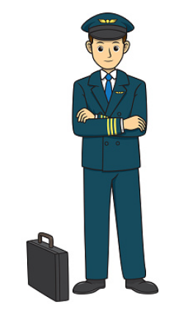
How to become a pilot
presentation by Dina Romanova
EAA Chapter 461

Slide 2
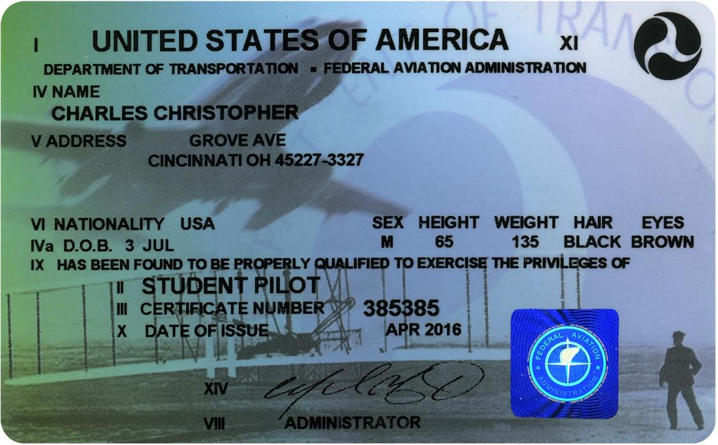
Types of certificates
Student Pilot – this is the learner’s permit
Recreational
Sport
Private Pilot
Commercial
Airline Transport Pilot (ATP)
Notes:
Student pilot certificate will allow you to fly solo

Slide 3
Student Pilot
it is a learner’s permit
allows you to fly solo
student must be at least 16 years old, and
must be able to read, speak and understand English
Restrictions:
cannot fly solo (alone) without an instructor endorsement
cannot take passengers
cannot fly for compensation or hire
cannot fly above the clouds
or when visibility is less than 3 miles (5 miles at night)
cannot fly into B airspace without a special endorsement
Notes:
Student pilot certificate will allow you to fly solo

Slide 4
Sport Pilot
the only pilot license that doesn’t require a medical
must be at least 16 years old, and
must be able to read, speak and understand English
must have Driver’s license
must have a minimum of 20 hours of flight time
Limitations:
can be a pilot-in-command only in a light sport aircraft
(max 2 seats, 600kg gross weight, max speed 120 knots)
cannot receive compensation
cannot fly if visibility is less than 3 statute miles

Slide 5
Recreational Pilot
must be at least 17 years old, and
must be able to read, speak and understand English
must hold a 3rd Class Medical Certificate (or Basic Med)
must have a minimum of 30 hours of flight time
must pass a knowledge test and a practical test
Limitations:
cannot fly airplanes with more than 4 seats
can carry no more than one passenger
passengers cannot pay for more than half of the expenses
no cross-country over 50 nm from the departure airport
cannot fly at night
cannot fly where radio communications are required

Slide 6
Private Pilot
must be at least 17 years old, and
must be able to read, speak and understand English
must have a 3rd Class Medical Certificate (or Basic Med)
must have a minimum of 40 hours of flight time (min 20 with instructor and 10 solo)
must pass a knowledge test and a practical test
Limitations and privileges:
can carry passengers
cannot receive compensation
but you can ask passengers to pay a pro-rata share for the operational expenses

Slide 7
Commercial Pilot
must have a Private Pilot Certificate
must be at least 18 years old, and
must be able to read, speak and understand English
must have a 2nd Class Medical Certificate
must have a minimum of 250 hours of flight time
Limitations and privileges:
can carry passengers
can fly for hire (except for the airlines)

Slide 8
Airline Transport Pilot (ATP)
highest level of piloting privileges
must have Commercial Pilot License
must be at least 23 years old, and
must be able to read, speak and understand English
must have a 1st Class Medical Certificate
must have a minimum of 1500 hours of flight time
Privileges:
can work as a pilot for the airlines
Notes:
most people get commercial pilot certificate and then work for tourism flights, skydivers, or flight instructors. You build hours and get paid.
Must hold either:
A commercial pilot certificate with an instrument rating
Or, meet the military experience requirements to qualify for a commercial pilot certificate, and an instrument rating,
Or, a foreign airline transport pilot license with instrument privileges

Slide 9
Ratings
Rating is not a special certificate, but something that is added to your certificate
Instrument
Single engine
Multi-engine
Land
Sea
Type rating (ex. Boeing 737)
Flight Instructor certificate (required Commercial pilot license)
Remote Pilot Certificate (to fly drones for commercial purposes)
Example: Private Pilot Single Engine Land

Slide 10
Certificates and Ratings

Slide 11
Medicals
AME – Aviation Medical Examiner
 | Age < 40 | Age 40 and above
First class medical certificate | 1st class for 12 months 3rd class for 5 years | 1st class for 6 months, 2nd class for 12 months, 3rd class for 2 years
Second class medical certificate | 2nd class for 5 years | 2nd class for 12 months, 3rd class for 2 years
Third class medical certificate | 3rd class for 5 years | 3rd class for 2 years
Basic Med:
If you had your Medical certificate in the past, and you know you can’t pass it again
If you were ever denied a Medical certificate, you cannot qualify for Basic Med

Slide 12
Flight Schools
CFR – Code of Federal Regulations. Some schools operate under CFR part 61, some under CFR part 141
Part 141:
use an FAA-approved training curriculum
this results in lower required training minimums (35 for PPL, 190 for Commercial)
training must be completed in order according to the syllabus
these schools have a lot more FAA oversight
some schools are allowed to do the checkride in-house (it means you don’t have to pay for DPE)
you can easily transfer part 141 training hours to part 61 school
it is possible to go to part 141 school and do the training under part 61 (but not vice versa)
usually (not always) is more expensive
Part 61:
usually there’s no organized curriculum
instructor decides what to teach you. He might or might not have a plan
more difficult to transfer flight hours if you are coming from a part 61 school
you can get flight training from a Certified Flight Instructor following FAR Part 61 without a school

Slide 13
Flight Schools
What to pay attention to when choosing a flight school:
part 61/141
proximity
aircraft options
towered/untowered airport
what ground school the school offers
choice of instructors
cost (ask the school what’s the average flight hours and total cost)
minimum number of hours is 40, but on average it takes 60-75 hours
Everything in aviation is more EXPENSIVE than expected,
and takes LONGER than anticipated

Slide 14
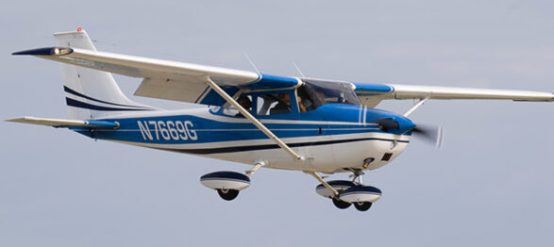
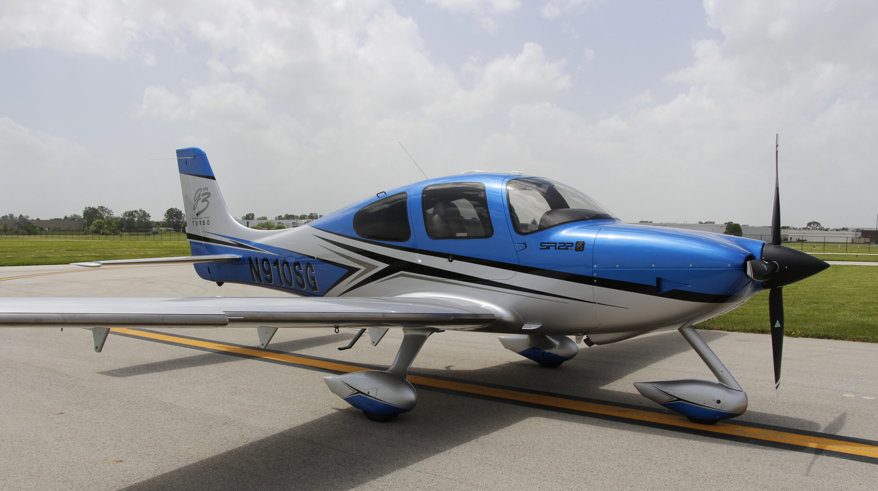
Aircraft options
Cessna 152 and 172: $150-160/hour
Piper Warrior: $150/hour
Diamondstar: $200/hour
Cirrus SR-20, SR-22: $370/hour

Slide 15
Average cost
Medical certificate $125
Airplane rent
$160 per hour
Instructor
$60-70 per hour
Ground school $300
Supplies:
headset
start from $200. Noise cancelling $800
books
FAR/AIM $20
FAA Pilot Handbook of Aeronautical Knowledge $20
Airplane Flying Handbook $20
logbook, fuel drainer, e6B, flight bag, charts, checklists, flashlight
(not required, but very useful) iPad (mini with cellular connectivity starts from $700)
Foreflight starts from $120/year
FAA private pilot written test $175
FAA checkride $650
Notes:
my online ground school plus bag and Cessna 172 manual was $365

Slide 16
EAA Scholarship
Deadline: March 1, 2023 at 12:00 pm Eastern Standard Time EST
Info & application on the EAA Website eaa.org
EAA awards more than $1.75 million in aviation scholarship money for Flight Training and Post-Secondary via various programs each year. EAA strives to provide scholarships that have a minimum award of $5,000.
EAA awards scholarships for those starting their flight training and those attending a post-secondary institution with a focus on aviation, including pilot training, aeronautical engineering, aviation management, airframe and powerplant (A&P) maintenance, and more.
APPLY NOW!!!!

Slide 17
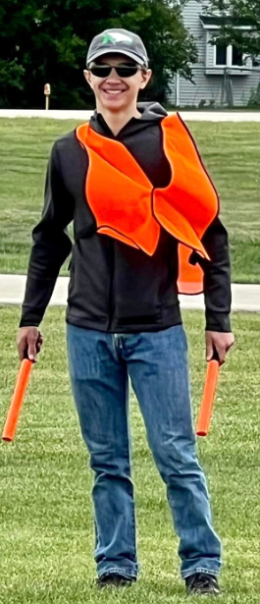
Ray Scholarship
The EAA Ray Aviation Scholarship is a scholarship program that is funded by the Ray Foundation, managed by EAA, and administered through the EAA Chapter network.
Through the generous support of the Ray Foundation, EAA provides up to $10,000 to deserving youths to cover their flight training expenses, totaling $1,550,000 in scholarships annually.

Slide 18
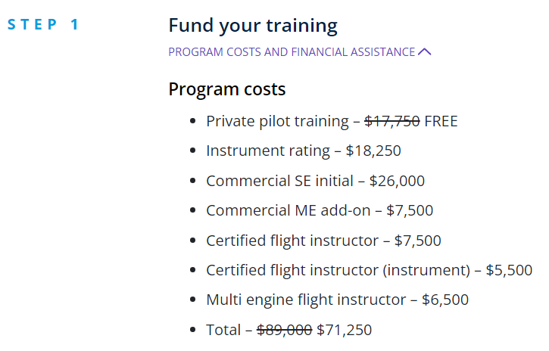
United Aviate program

Slide 19
College
FAFSA loans (lower interest rates than personal loan)
you will build your network contacts
airline often recruit from these universities
minimum number of hours to get an ATP license drops from 1500 to 1000
some of the well-known universities are
Embry-Riddle
University of North Dakota

Slide 20
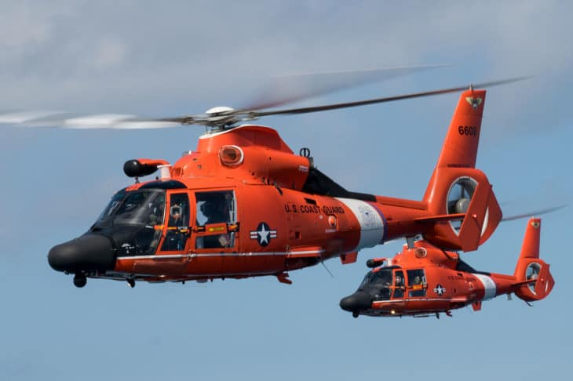
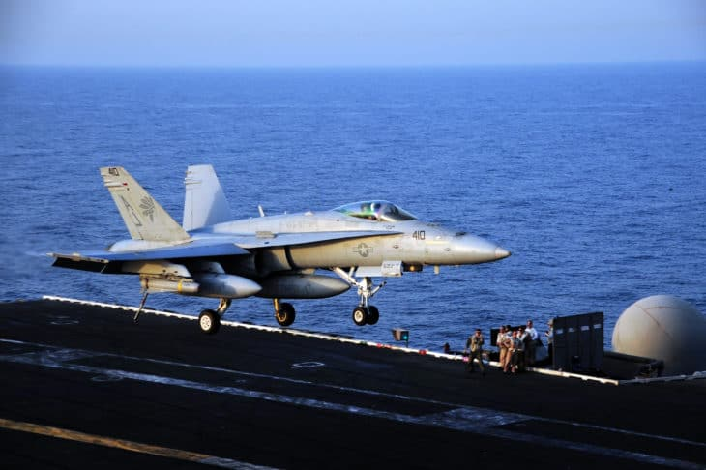
Military
There are pilot jobs in every military branch:
Air Force
Navy
Army
Marines
Coast Guard
incredibly competitive
if you want to transition to an airline pilot later, you need hours flying a fixed-wing

Slide 21
Tips to save money
fly often
have the money ready (so you don’t have to pause your training)
be prepared: study the procedure before the lesson
observe flights if your school allows you to watch others
study groups, listen to ATC, discuss in the aviation community
use a simulator (practice what you’ve learned in real airplane, but don’t do anything new)
online ground school with unlimited access
Notes:
online ground school saves money because you can review the material over and over again

Slide 22
Ground School
In-person (at flight schools)
could be more specific about your airplane or school
you get your questions answered right away
you can’t rewatch the lessons, you will need to take notes
you are tied to the schedule
Online:
is less expensive
you learn at your own pace
you can pause and rewatch lectures
variety of school options:
Sporty’s
Kings schools
Gleim
Pilot Institute
Sheppard Air
Gold Seal
Fly 8MA
Part time pilot
Checkrideprep
learnthefinerpoints.com – videos of maneuvers from the pilot view
Notes:
in-person: could be more specific about your airplane or school, your questions are answered immediately
can’t pause if you are tired or rewind, rewatch the previous lesson

Slide 23
Flight Training
Pre-solo (maneuvers, landing)
Cross-country training (navigation, weather)
Getting ready for checkride

Slide 24
Flying solo
Essential Endorsements:
Pre-Solo Knowledge 61.87 (b)
Pre-Solo Flight Training 61.87(c)
Initial Solo 61.87 (n)
As Needed Endorsements:
Each additional 90 calendar-day period 61.87(p)
Solo Flight at Night 61.87 (o)
Take-Offs and Landings at an Airport within 25nm 61.93 (b)(1)
Solo in Class B 61.87 (a) and/or (b)

Slide 25
Exams
Aeronautical Knowledge Test (written)
Checkride (oral and flight)

Slide 26
Aeronautical Knowledge Test
written exam
2 hours to complete
60 multiple-choice questions
must get 70% to pass
$175
is good for 2 years

Slide 27
Practical Exam
Examiners:
DPE – Designated Pilot Examiner. It’s not an FAA employee, but an FAA contractor. It’s a private pilot, flight instructor, who applied to FAA to be an examiner. Cost $400-800
FAA ASI – Aviation Safety Inspector. Free, but very difficult to get a hold of them
Checkride consists of two parts:
Oral exam
Flight Review

Slide 28
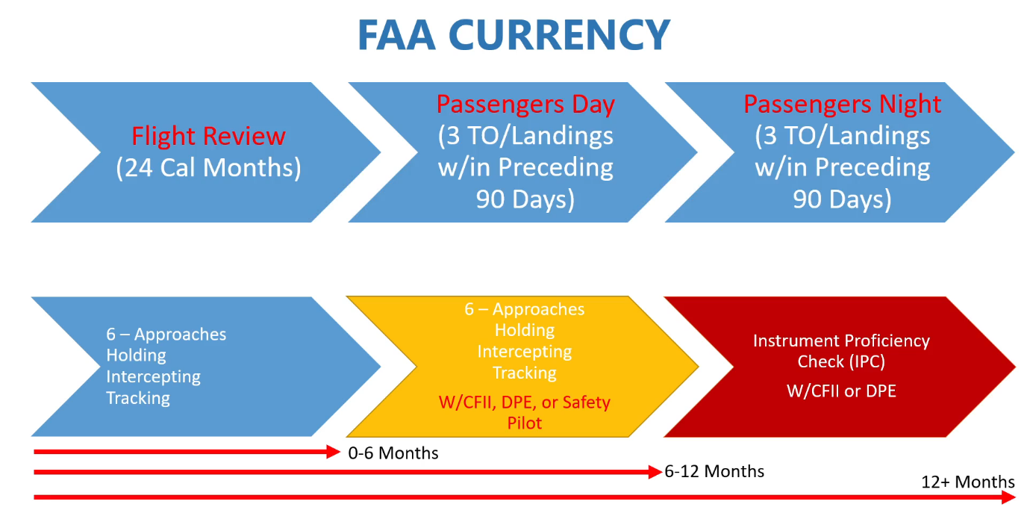
How to stay current

Slide 29
Tips
Do the medical first
Instructor could be wrong
Establish your personal limits
Thorough pre-flight. IMSAFE
Follow the checklist
Pay attention to stalls and spins: know how they occur and how to recover
If you fly in the mountain area, make sure you understand pressure altitude and your plane’s limitations
Keep cash in your flight bag
Have options
Currency ≠ Proficiency
Notes:
limits for runway length, crosswind, night time flying, altitude
Illness: Do I have any symptoms? Medication: Have I been taking prescription or over-the-counter drugs? Stress: Am I under psychological pressure from the job? Am I worried about financial matters, health problems, or family discord? Alcohol: Have I been drinking within 8 hours? Fatigue: Am I tired and not adequately rested? Emotion: Am I emotionally upset?

Slide 30
License to learn
FAA Safety WINGS Pilot Proficiency program https://www.faasafety.gov/WINGS
Chicago Annual Aviation Expo
Saturday January 28 @8am-4pm
IFR/VFR/Companion seminars
https://www.faasafety.gov/SPANS/event_details.aspx?eid=119297
EAA webinars
EAA Chapter 461

Slide 31
Thank you!
Questions?

